Slide 1
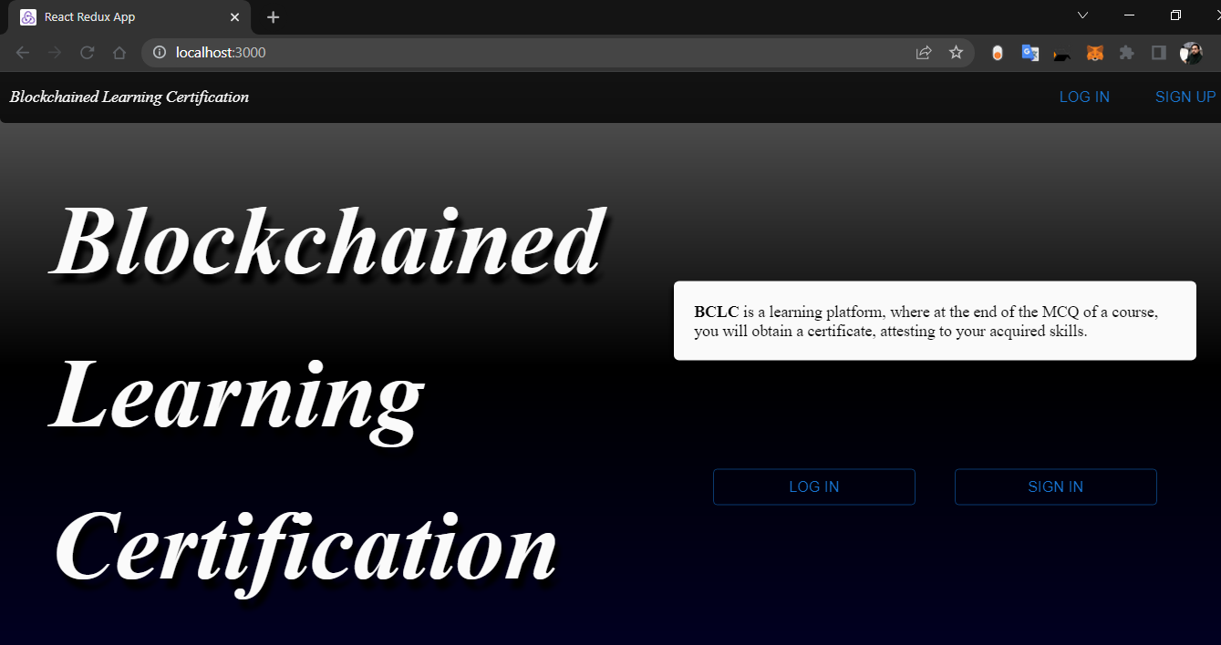

Notre logo + bclc.dz
Our partners
Our programs
Login
SignUp
Contact Us
Animated space ( liste of pictures at the same size of this spot animated)
Il send a module i use to use it on html pages
Espace TEXT ill put info about the système or maybe stats
Zone Text

